Slide 1
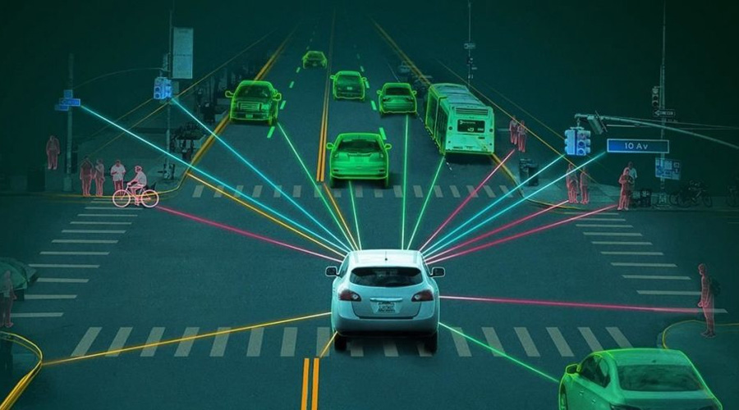
GovHack 2024
CrashWise AI
Generative AI Based Fully Automated Crash Analysis and Road Safety System
Solution by Gryffindor

Slide 2

AI based solution to analyze road statistics
and provide optimizations (Victoria)
Challenge
Create innovative solutions for predicting, preventing, and responding to road accidents. Leverage data from road crashes, traffic patterns, and environmental conditions to harness AI effectively and creatively.
Our aim is to create a more sustainable environment and ensure to efficiently utilize historical data to analyze trends and patterns in designing strategies for the future.
The main challenge is gathering the vast amount of historical data and using it to draw conclusions. To determine trends on causes of road accidents, improve traffic management and formulate evidence based policies.
Eligibility: Use at least 1 dataset from Data.Vic list.
Entry: Challenge entry is available to all teams in Australia.
Our Solution elements
Data integration and management
Traffic analysis and historical data analysis
Crash hotspot analysis using agents and ML bots.
Bots to provide Preventative measure, guidelines
Crash predictive analysis
Preventative measures and policy guidelines
Customizable recommendation algorithms based on user input and historical data
Build Generative AI based fully automated robots to process and recommend.
Data Sets Used
Traffic Signal Volume Data
Traffic Volume
Victoria's Road crash data

Slide 3
Importance of Crash analysis and modelling
Data integration and management – Accurate, Efficient and Scalable.
Enables focused and effective solutions for different tasks using Multi agent architecture.
Predictive Power: Anticipates high-risk areas and potential crashes. Actionable Insights: Offers practical solutions and policy suggestions. Data Analysis: Reveals patterns and trends to inform safety strategies..
AI and ML based campaigns that targets users of different age brackets using historical analysis.
NextGen AI and chat bot that produces effective data insights and answers for users.

Slide 4
Actions and how we want to achieve
Data Collection and preparation – Collect pertinent historical data which includes crash analysis, road usage data, etc. Using APIs or data sharing agreements to gather real-time and historical data for analysis.
Set up ETL (Extract, Transform, Load) processes to handle data ingestion. Implement data cleaning techniques to remove inconsistencies and errors.
Use messaging systems (e.g.,, Kafka) for effective agent communication. Ensure agents can share data and insights effectively and load to Splunk for ML actions.
Use server-side technologies to manage data processing and agent integration. Created RESTful APIs for communication between the front-end and back-end. Using this create AI generated policies e.g. better road safety, targeted campaigns etc.
Designed R-based algorithms for generating actionable recommendations based on data insights available in the data sets. We also use reinforcement learning or rule-based systems to suggest preventive measures and policies that will be helpful for the public.
Technological Advances - Design algorithms to analyze data from different streams, enabling more accurate characterization, sorting, and process optimization which helps in developing the strategy . Automate and create pipelines as well as continuous learning models.

Slide 5
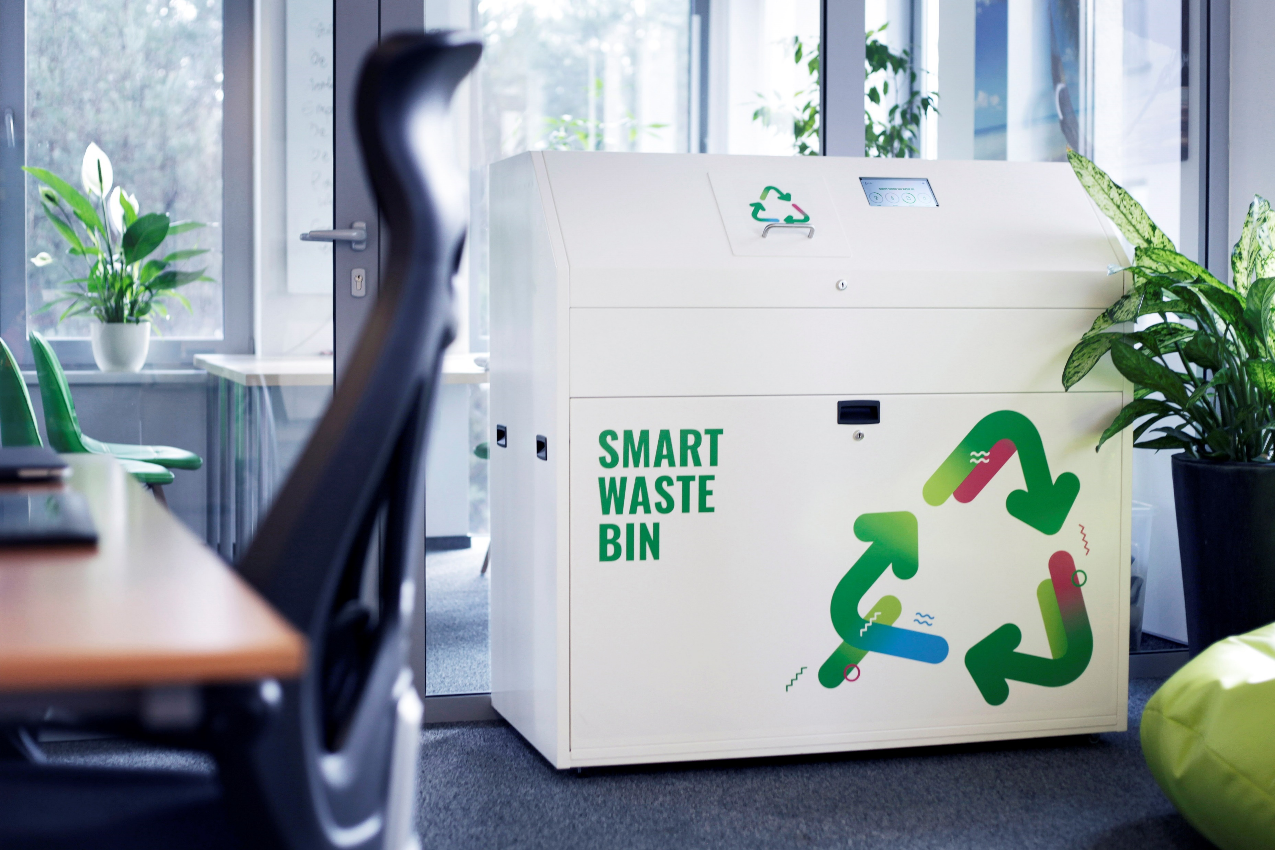

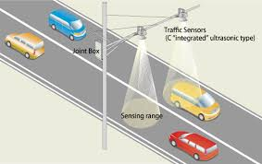
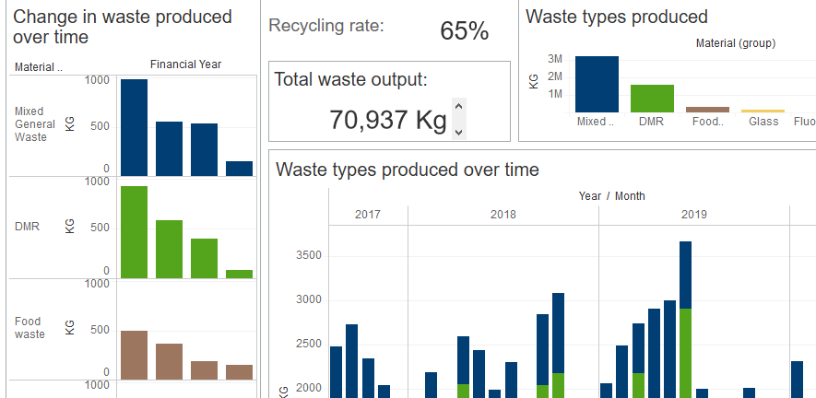
Generative AI Based Fully Automated Crash Analysis and policy definition system
Key Process of future generative AI based crash analysis and policy definition system:
Collect the pertinent historical data from a variety of state-wide data sources which includes risk, crash analysis and policy definitions.
Identify trends, accidents, causes and traffic issues in hand.
Process the raw data and combine them into one coherent dataset to avoid any data discrepancies. This is done using R and Splunk.
Classify the collected data based on different categories of issues and identify opportunities for better traffic management activities e.g. time based lane usage, traffic detours, etc.
Feed the data into the AI systems which analyze and provide the insights on road usages, pedestrians, traffic controls and patterns.
Enable RFID sensor based road monitoring to identify traffic movement.
AI systems analyze the unprocessed data from these sensors, predict the behaviors. Also, signal AI-based robots to identify and alert on any traffic light issues for better management..
Data Collection (Sensor’s / AI / ML based)
GenAI and Chatbot
Analysis, reporting and processing using standardized tools, policy definition

Slide 6
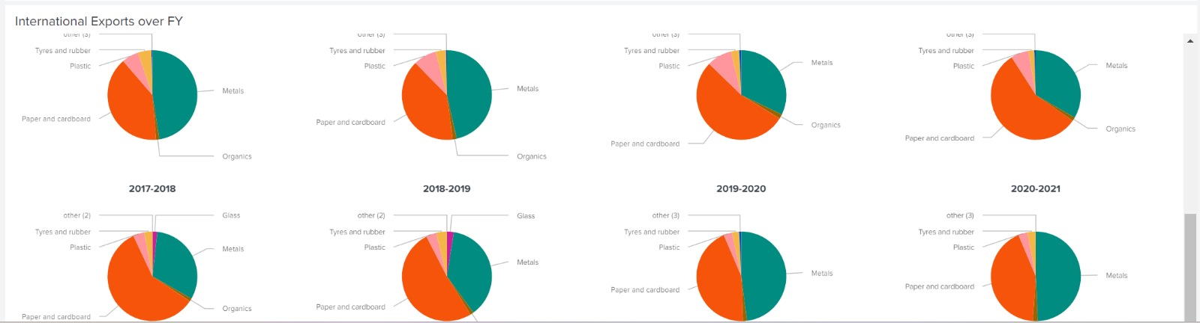
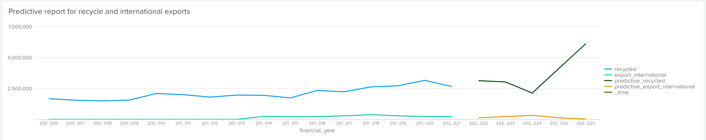
Generative AI Based Predictive Analysis Dashboard & Reports
Pie Charts
Predictive Analysis

Slide 7
Thank You
Team Gryffindor

